Slide 1

Coorens-Behjati lab meeting
15/01/2026
x

Slide 2
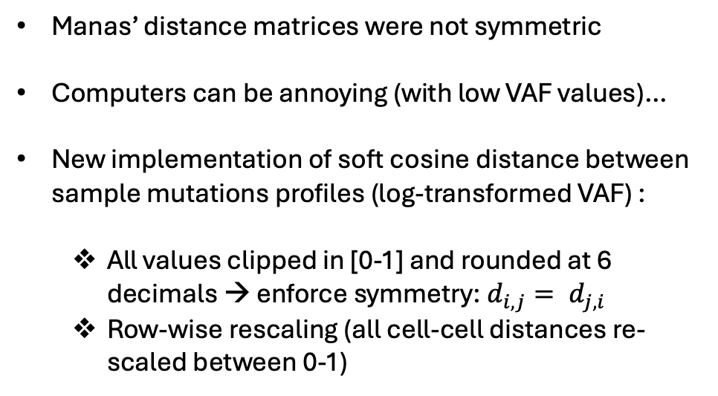
Embryo project: fix (minor, but annoying…) problems with old soft cosine similarity distances
Manas’ distance matrices were not symmetric
Computers can be annoying (with low VAF values)…
New implementation of soft cosine distance between sample mutations profiles (log-transformed VAF) :
All values clipped in [0-1] and rounded at 6 decimals → enforce symmetry: $d_{i,j}= d_{j,i}$
Row-wise rescaling (all cell-cell distances re-scaled between 0-1)
New values are almost perfectly correlated to old ones (just cleaning up the mess of numerical approximation and re-scale to make distances differences bigger and comparable for clustering)

Slide 3
Embryo project: clonal composition structure across LCM samples
Hierarchically clustered distances
“Some” diagonal-block structure
No obvious clustering structure

Slide 4
Embryo project: no “global” correlation between physical and genetic distances
No (evident) global relationship between pairwise genetic and physical distances

Slide 5
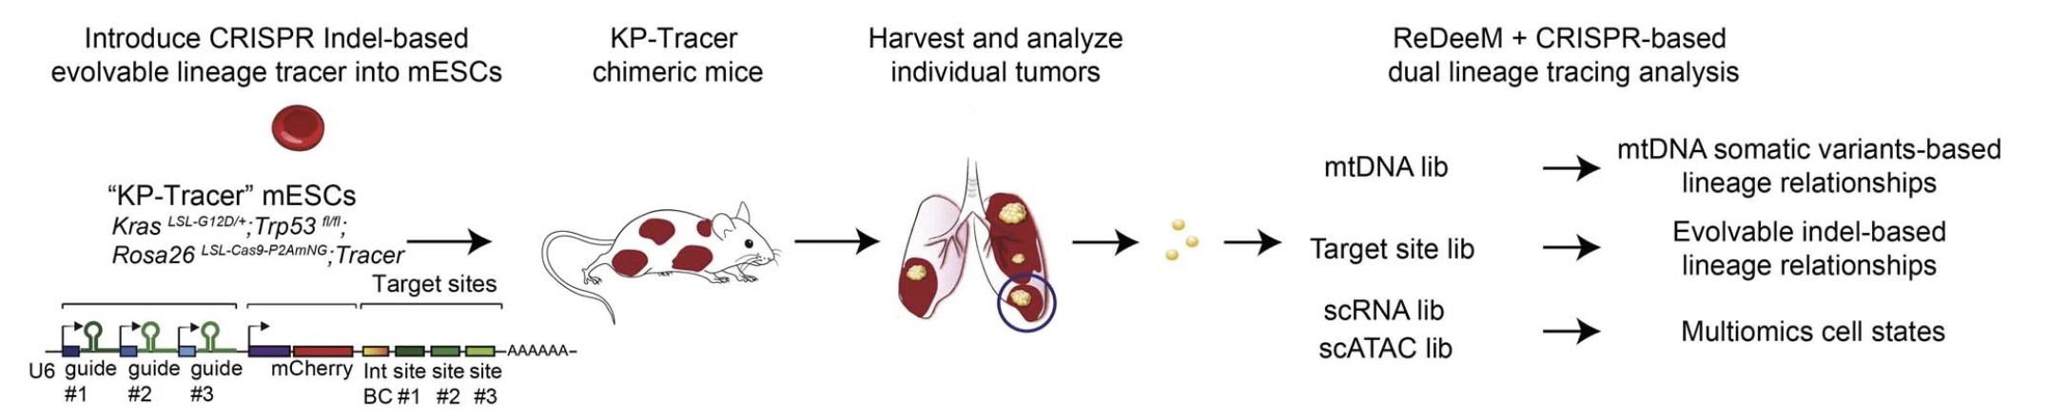
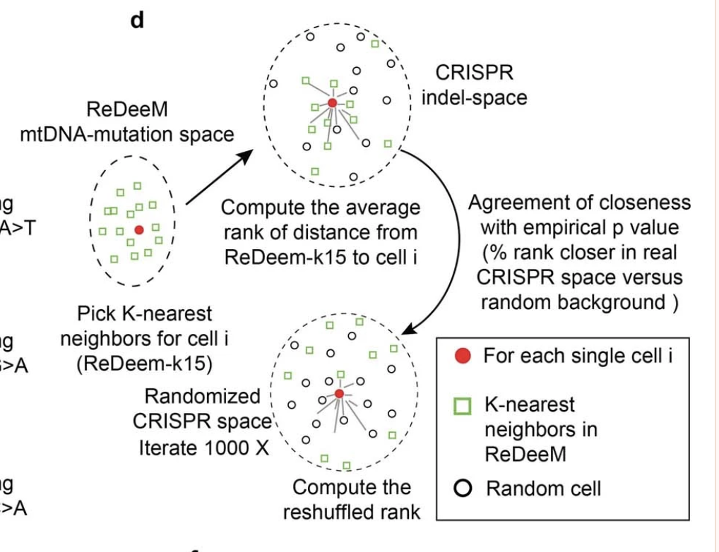
Embryo project: what about “local” correlation? Agreement of Closeness (AOC) metric
Weng et al., Nature 2024
Are physically proximal LCM samples locally similar in genetic space?
Can we use the AOC metric to associate distances in physical and genetic spaces among LCM samples?

Slide 6
Embryo project: breaking down AOC, in our case
Euclidean distances in physical space
k-nearest-neighbor (kNN) graph
Soft cosine distances in genetic space (VAF mutation space)
Observed rank: the rank (across all ordered genetic distances for the sample i) of the mean genetic distances between sample i and its k nearest neighbors in physical space
Random rank: the rank (across all ordered genetic distances for sample i) of the mean genetic distances between sample i and a random selection of other n=k samples
AOC: mean (across n=1000 random trials) difference between random ranks and the observed rank, normalized by the number of total samples. AOC >> 0 → random rank >> observed
p value: Fraction of trials for which random rank < observed rank

Slide 7
Embryo project: Physically proximal LCM samples show significantly similar clonal composition

Slide 8
Embryo project: physical and genetic dissimilarity in kidney’s anatomical substructures
Few AOC differences among kidney’s anatomical regions

Slide 9
EMBO proposal: what we would like do
Chemotherapy-induced changes in immune cells epigenome
and long-term effects in childhood cancer survivors

Slide 10
EMBO proposal: summary, pt I
Background
Chemo: still an unavoidable option of cancer treatment. Systemic cytotoxicity: normal tissue damage and long-term side-effects. Unknown cellular and molecular mechanisms.
Mitchell et all., 2024 and Pitch et al., 2025: treatment-specific effects of chemo-agents on somatic landscapes (mutational signatures, burden, driver selection etc.)
DNA-damage and epigenetic de-regulation: aging hallmarks
Immune system (proteomic) age acceleration, alone: mortality and aging-related pathology biomarker (See-Hwee Hoo et al., 2025)
Causal links between DNA damage and CpG de-methylation (Koch et al. 2025)
Motivation
Understanding chemo effects require integrated characterization of changes in cell type composition, clonal and somatic landscapes, and epigenetic re-wiring of normal tissues
Main hypothesis
Due to its high relevance and samples/data availability, we will start from blood
Chemo reshuffles all of the above, causing “aging-like” phenotypes in normal tissues that are
responsible for long-term side chemo effects

Slide 11
EMBO proposal: summary, pt II
Strategy, in 5 aims:
Aim I (months 1-12): generate longitudinally matched genomic and epigenomic data for a clinically relevant subset of the VIVO biobank.
Aim II (months 6-18): quantify changes in somatic mutation (i.e., SNVs and INDELs) burden, selected genes, clonal expansions, cell type composition, and aging rates driven by different chemotherapy agents
Aim III (months 8-24): map the changes from Aim III to known regulatory elements, genes, gene expression programs and pathways
Aim IV (months 12-24 and future work): generate single-cell multi-omics data (i.e., targeted proteomic, DNAm, and SNVs) to link chemotherapy-associated somatic mutation and DNAm events in their cell type context
Aim V (months 18-24 future work): Validate some of the findings of Aim II-IV (i.e., related to hematopoietic tissue) in the UK biobank, leveraging whole genome sequencing and targeted methylation data along with rich clinical annotation (before sample collection, and at follow-up)

Slide 12
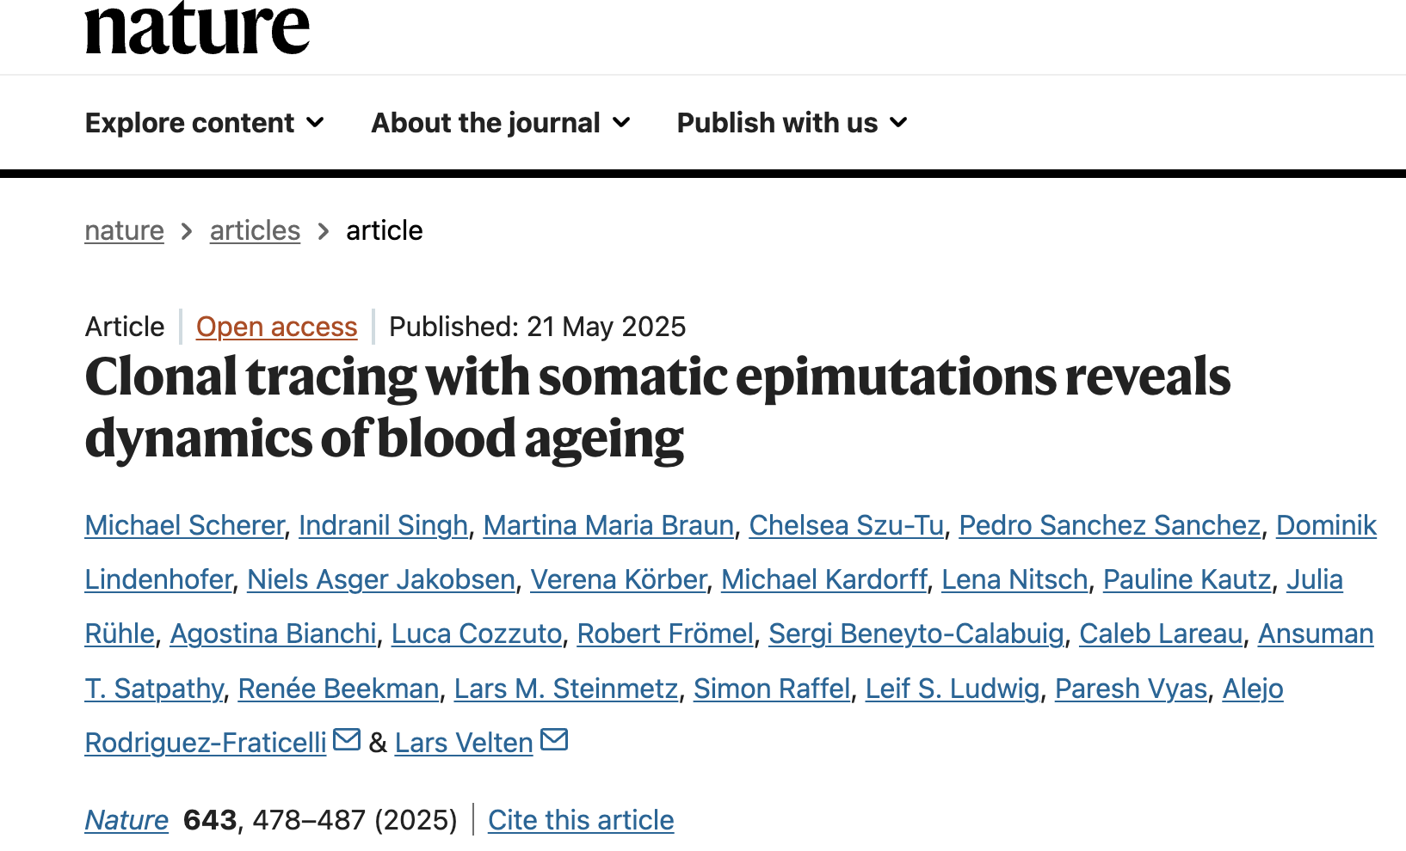
Aim IV focus single-cell multi-omics data (DNAm + SNVs + protein abundance)

Slide 13
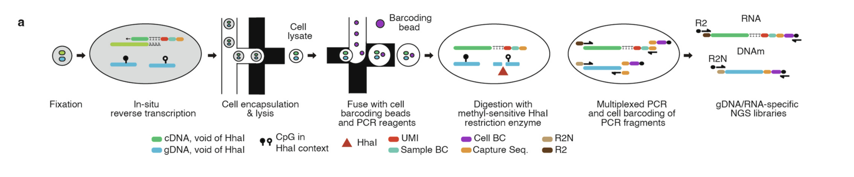
Aim IV focus single-cell multi-omics data (DNAm + SNVs + protein abundance)
scTAM and scTAM(ARA)-seq
Tapestri (Mission Bio)-based single-cell multi-omic platform
Simultaneous measurement of up to 1000 genomic features (SNVs, DNAm features)
+ protein (Ab based) abundance

Slide 14
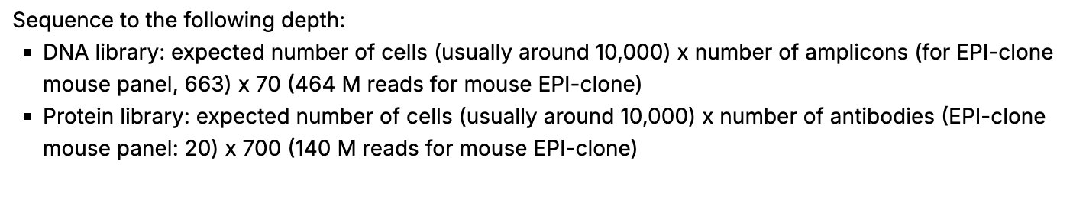
Aim IV focus: scTAM-seq sequencing requirement and scalability
From the publicly available protocol: https://www.protocols.io/view/epi-clone-clonal-tracing-with-somatic-epimutations-4r3l29dzjv1y/v1

Slide 15
EMBO proposal: summary, pt III
Expected results:
Detailed and comprehensive characterization of chemo-related effects on the immune cell landscape
Testing the age acceleration hypothesis
Mechanistic, single-cell level insights about the interplay between somatic mutations and methylome
Clinical association of epigenomic features and patients’ histories: biomarker development of chemo-related toxicity
Comparison between childhood and adults’ malignancies: does the age context matter?

